Slide 1
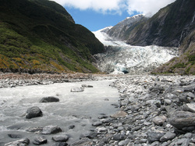
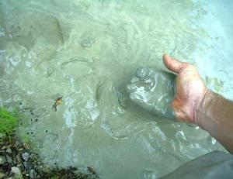
What is clay?
Minerals from the earth – specifically silica and alumina. Often clay is found near rivers where small particles of rock are carried down to a lower part and collect together to form clay.
Clay is plastic when it’s wet – can be pushed, stretched, stamped, or impressed
Clay shrinks as it dries
Clay hardens as it dries
Clay becomes hard, durable, and waterproof when subjected to sufficient heat

Slide 2
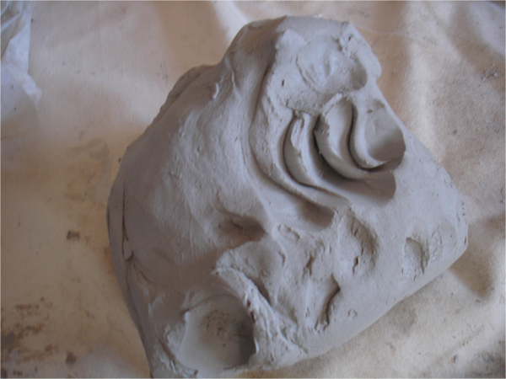
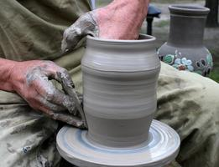
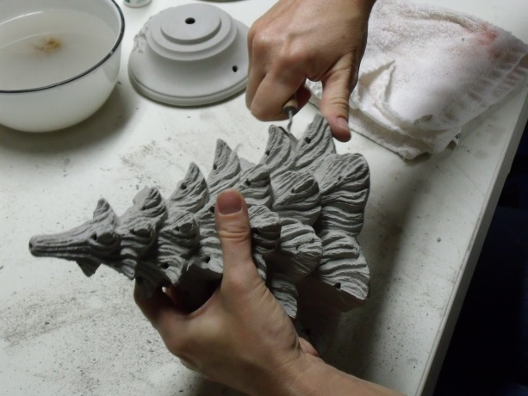
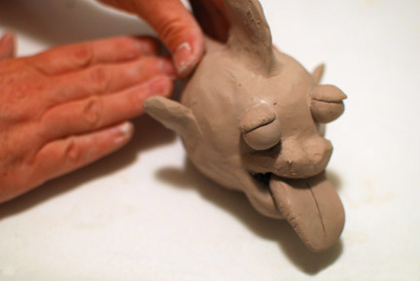
How do we work with it?
Plastic Stage
Workable
Moldable

Slide 3
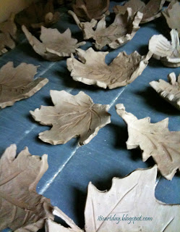
Greenware Stage
Wet
Damp
Leather-hard
Bone dry
Once it is dry and light gray it becomes very fragile

Slide 4
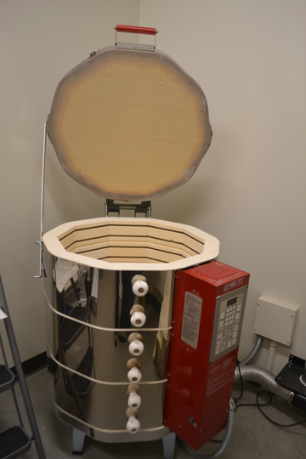
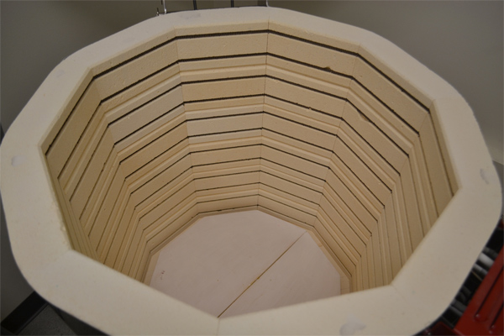
Electric Kiln
Notes:
Today we use a special electric oven called a kiln to cook the clay. How hot does your kitchen oven at home reach when you are cooking food? 375 or 400 degrees F? Our kiln will cook your projects at about 1800 -2000 degrees F. (show photo of kiln)
Cooking in a kiln is called firing. This is important because it makes the clay stronger and more waterproof. Clay that has been kiln fired would not return to a soft state even if it were in water for a long time. That is because the extreme heat causes permanent physical and chemical changes to occur. These reactions, among other changes, cause the clay to be converted into a ceramic material.

Slide 5
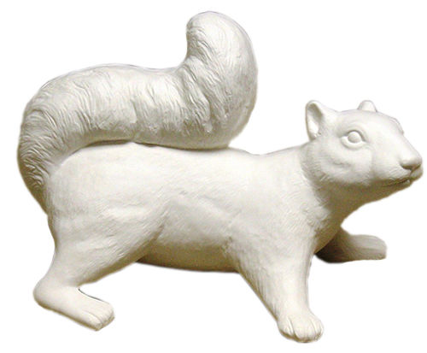
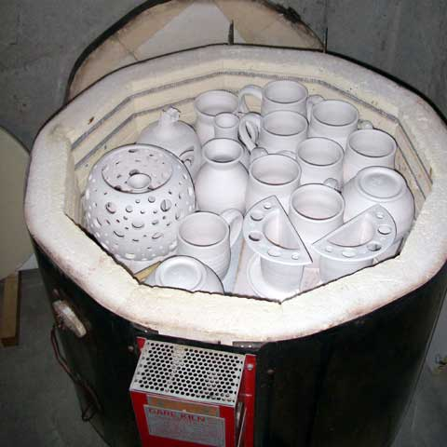
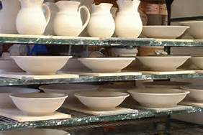
Bisqueware Stage
After fired in the kiln
Does not break that easily
The grey clay turns white

Slide 6
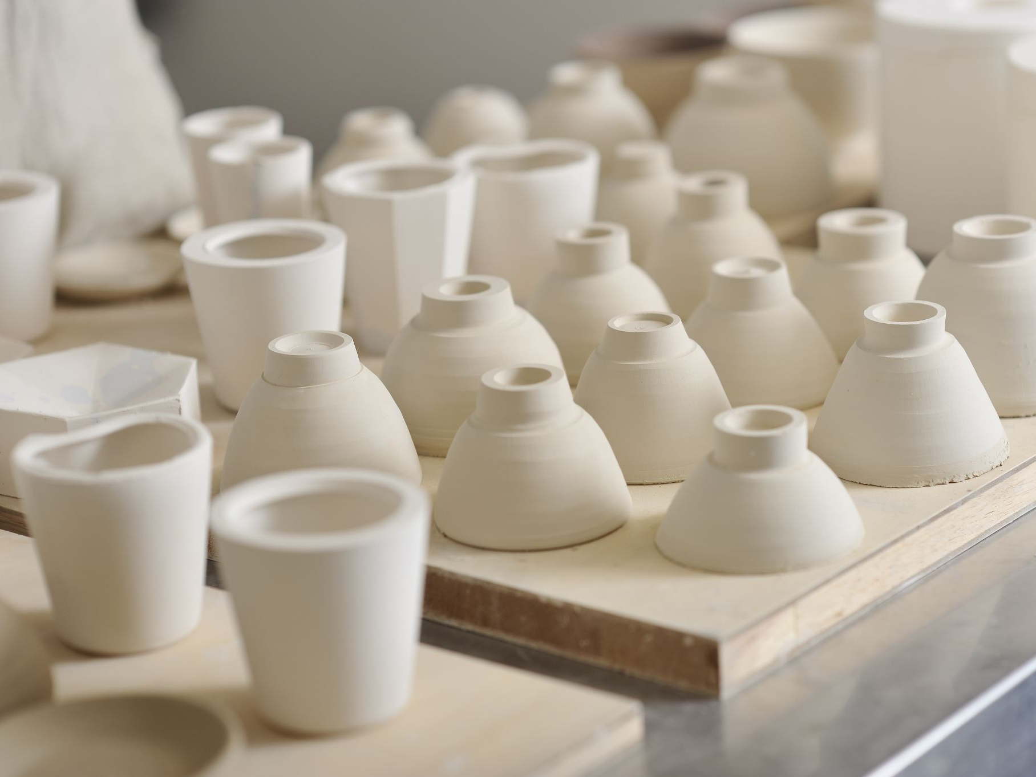
All About Clay
Dry it (greenware)
Heat it (bisque firing in kiln)
Glaze it (liquid glass paint)
Heat it again (in kiln)
Notes:
These projects we make today will need to dry in the open air for a week or two (this is the greenware state-•Greenware (noun) is the term given to clay objects when they have been shaped but have not not yet been bisque fired, which converts them from clay to ceramic. Greenware may be in any of the stages of drying: wet, damp, soft leather-hard, leather-hard, stiff leather-hard, dry, and bone dry.)
When they are completely dry they will be fired in the kiln for the first time (bisque fired) and look like this when they are done (hold up a sample of bisque fired piece).
After that, I will come back and you will paint the projects with something called glaze which is a special liquid like a paint that’s made of bits of ground up glass. The piece will then be fired again in the kiln and will turn out like this (show a real glaze fired piece).
Getting started:
Students receive one canvas cloth on the desk, one slab of clay, dull pencil for writing name, cutting knife, texturizing tools (tongue depressors, screws, marker caps, etc.), tagboard template of project, tray for project drying, bowl with few drops of water for fingertip smoothing)

Slide 7
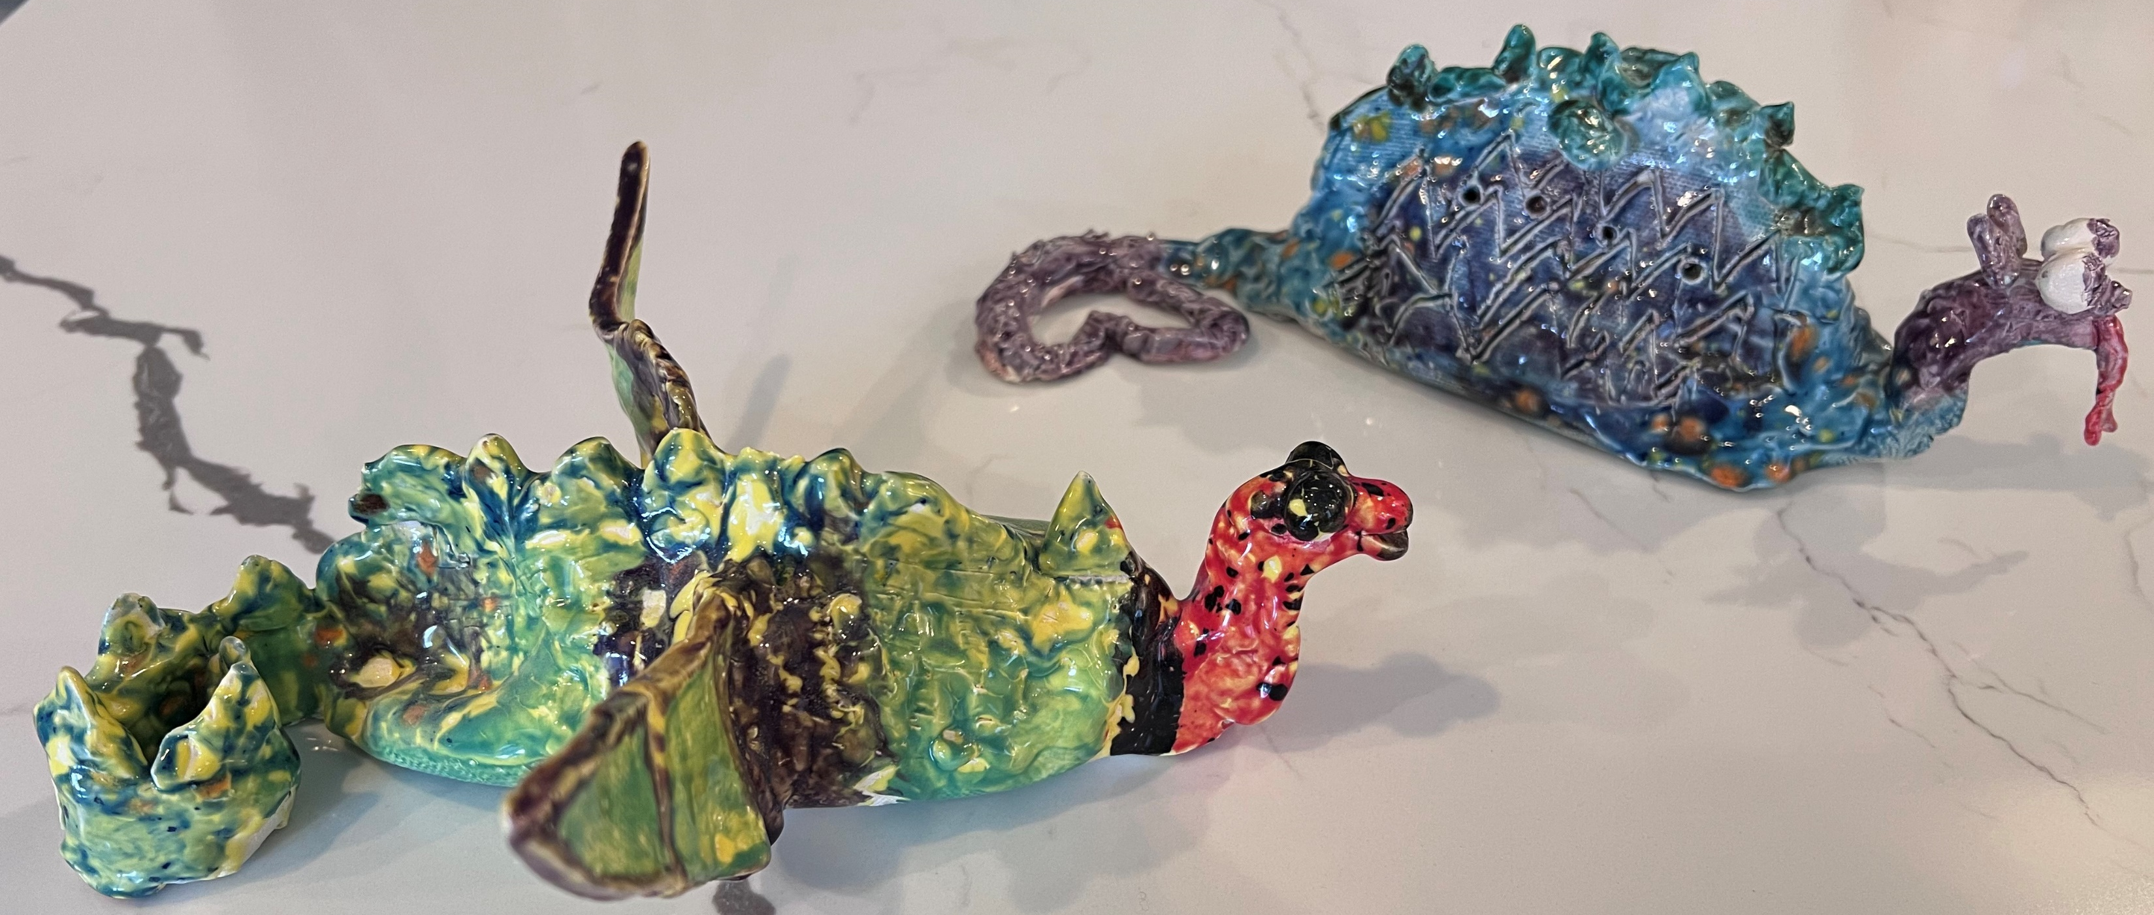
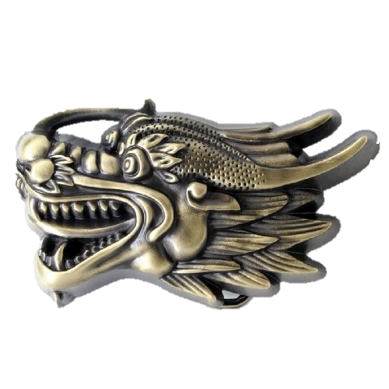
Clay Project: Eastern Dragon

Slide 8
Eastern Dragon
East: China, Japan, Korea, SE Asia
Prominent in arts, literature, poetry, song
Considered beautiful, wise, bringers of good luck, good fortune, powerful, divine
Believed to rule the lakes, ocean, rain
Notes:
By “Eastern”, we are primarily referencing how dragons are portrayed in China, Japan, Korea, and SE Asia (e.g. Vietnam, Cambodia) and to some extent, India.
Dragon images and myths are found in Eastern art (paintings, clothing, statues, jewelry), literature (myths, stories), poetry, and song.
Unlike Western dragons, which are considered evil (fire-breathing, greedy, terrorizing and eating humans), Eastern dragons are revered and considered noble, wise, and good.
Eastern dragons are often associated with water – having power over water and able to control the weather. In times of drought, offering were made to the dragon king.

Slide 9
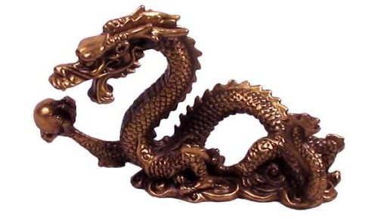
Features
Snake-like bodies
4 legs, toes
Other animal elements (e.g. tiger paws, eagle claws, stag horns, carp scales)
Chimu (lump on its head), allows it to ascend to the sky
Notes:
Eastern dragons are often comprised of several animal shapes. They are generally serpentine in shape. Other animal elements include tiger paws, deer/stag horns, scales of a carp, belly of clam, head of a camel, etc. One theory states that the emperor would incorporate the tribal totem of each region he conquered (thus the amalgam of animals).
The Chimu (chee-moo) is unique to the Eastern dragon and is said to give the dragon the power to ascend to the sky.

Slide 10
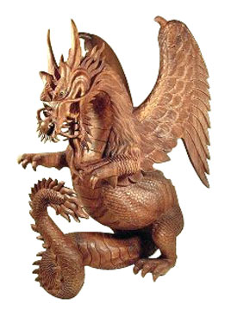
Symbolism
Pearl (wealth, prosperity) people will buy dragons for good luck business gifts, wedding gifts
117 scales (81 positive, 36 negative)
Number of Toes (more toes, more power)
Color
Azure/blue = compassionate
Red = blessings
Gold/yellow = king
White = virtuous, pure
Black = mystic
Notes:
Eastern dragons are often portrayed holding a pearl or orb. The pearl is generally thought to represent wealth, prosperity, and luck. The pearl may also give the dragon certain powers. Due to the symbolism and popularity of the dragon, dragon statues and dragon-themed items are often chosen as art work for businesses or important locations.
The 117 scales are said to be comprised of 81 Yang/positive energy and 36 Yin/negative energy scales. These amounts are all factors of 9, an important and auspicious number. The dragon itself is often described in terms of 9 attributes.
The number of toes was used to depict the type of dragon (5 for the emperor, 4 for nobility and high ranking officials, 3 for lesser nobility). It was a capital offense to improperly portray a gold-colored, 5 toed dragon.
Eastern color symbols tend to differ from western symbolism. For example, red is a color of blessing and good fortune (it is the color of the bridal gown in China and India). White is considered pure but is also the color representing death (as opposed to black).

Slide 11
Dragons in Culture
Dragon boat racing (to honor the water dragons)
Dragon dance (to celebrate special events)
Symbol of Chinese emperors, royalty
Architecture/Art (dragons that guard are placed on prisons, bridges; dragons that cry are placed on bells, dragons that like music are placed on bells, dragons that kill are put on swords)
Notes:
Dragon boats are long canoe-like boats with a dragon head carved on the front end of the boat. A team of 10-22 people (including a drummer) race. This tradition originated over 2000 years ago in China and is extremely popular in numerous countries.
Dragon dance – where a team of dancers use poles and hoops to make “a dragon” come alive. The dance honors the dragon and is performed at special events such as New Year’s.
Dragons were the chosen emblem of the Chinese emperor in ancient times.
Dragons are still commonly used in art and architecture. There are several different types of dragons and they are incorporated into items depending on their function. For example, a type of dragon that likes to guard is often displayed at entryways and prisons. Dragons that cry are placed on bells. Dragon who like to swallow are placed on ridgepoles for roofs to swallow evil influences.

Slide 12
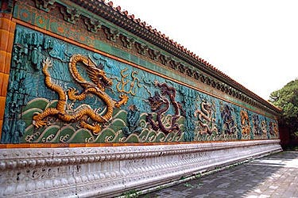
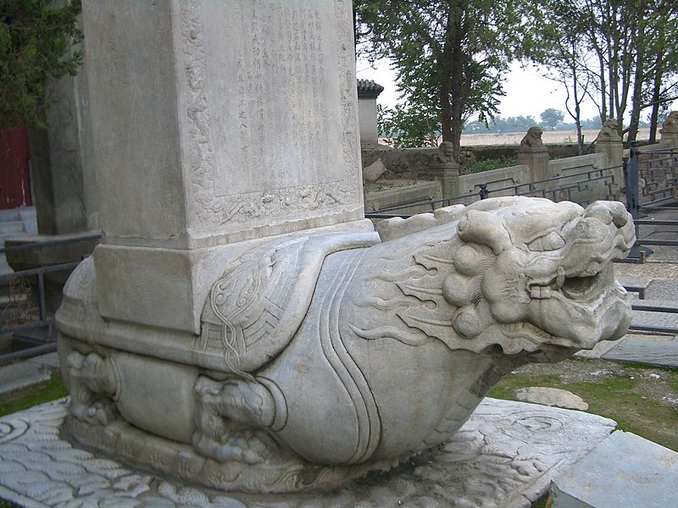
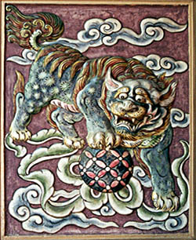
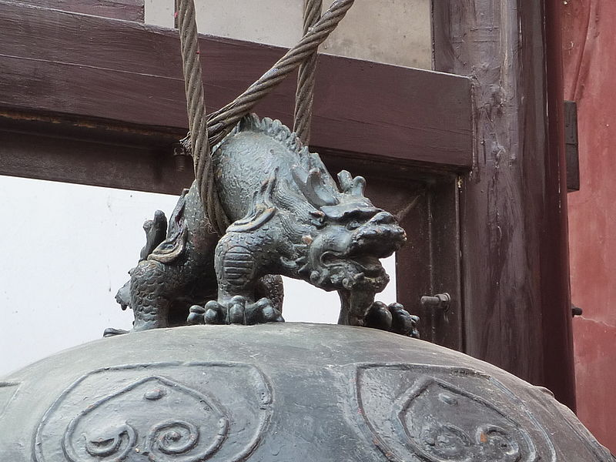
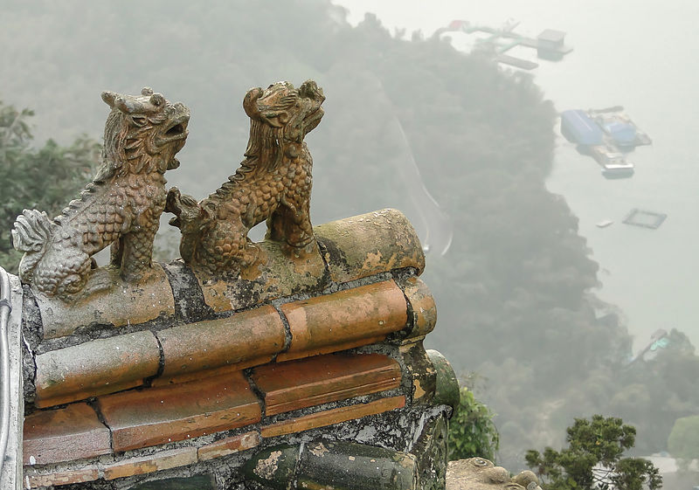
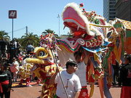
Eastern Dragons in Art/Architecture
Nine Dragon Wall
(in Beijing, China)
Dragon on Bridge
(Marco Polo Bridge in West Beijing)
Guarding dragon
Crying dragon
(Wudang Palace bell)
Dragons on a roof
(Sun Moon Lake in Taiwan)
Dragon dance

Slide 13
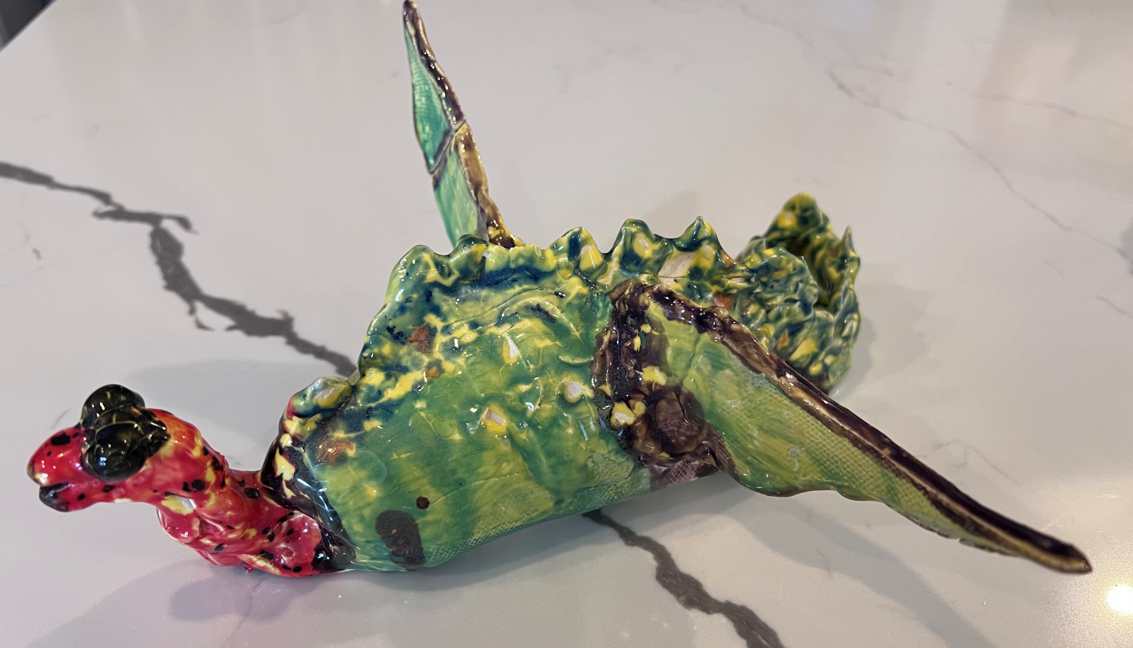
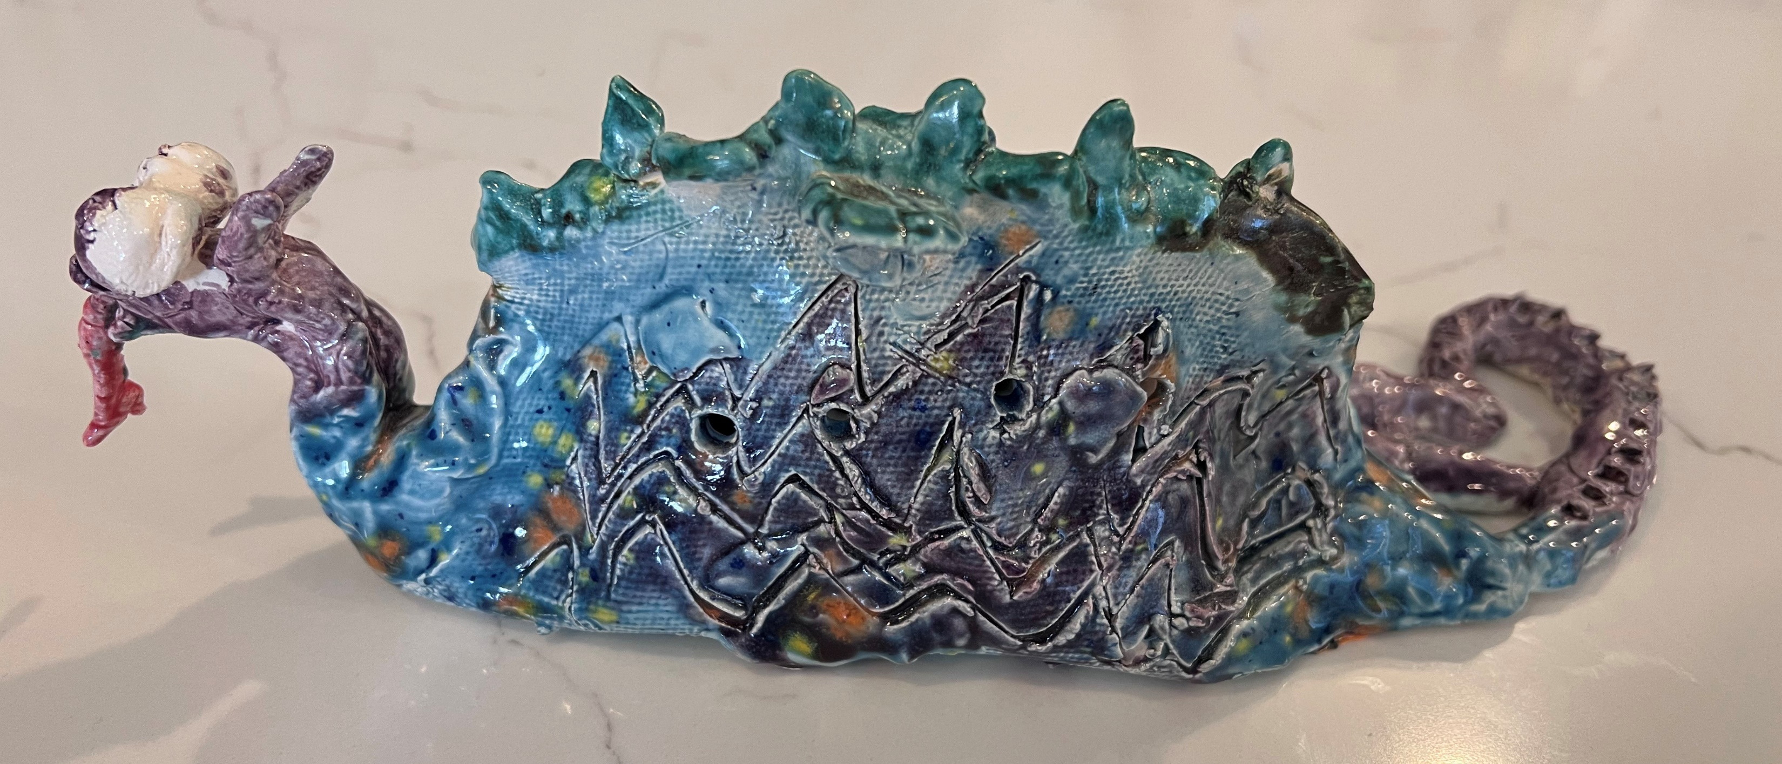
Think About Your Dragon
Culture
Culture affects aesthetics (idea of what looks good)
Use
Use tools and hands to create lines, details, texture, patterns
Try
Try different processes
Additive (adding dots, noses, wavy lines)
Subtractive (removing clay to make scales, skin, lines)
Express
Express feeling/ideas
happy dragon
protective/fierce dragon
content/fat dragon
calm/peaceful dragon

Slide 14
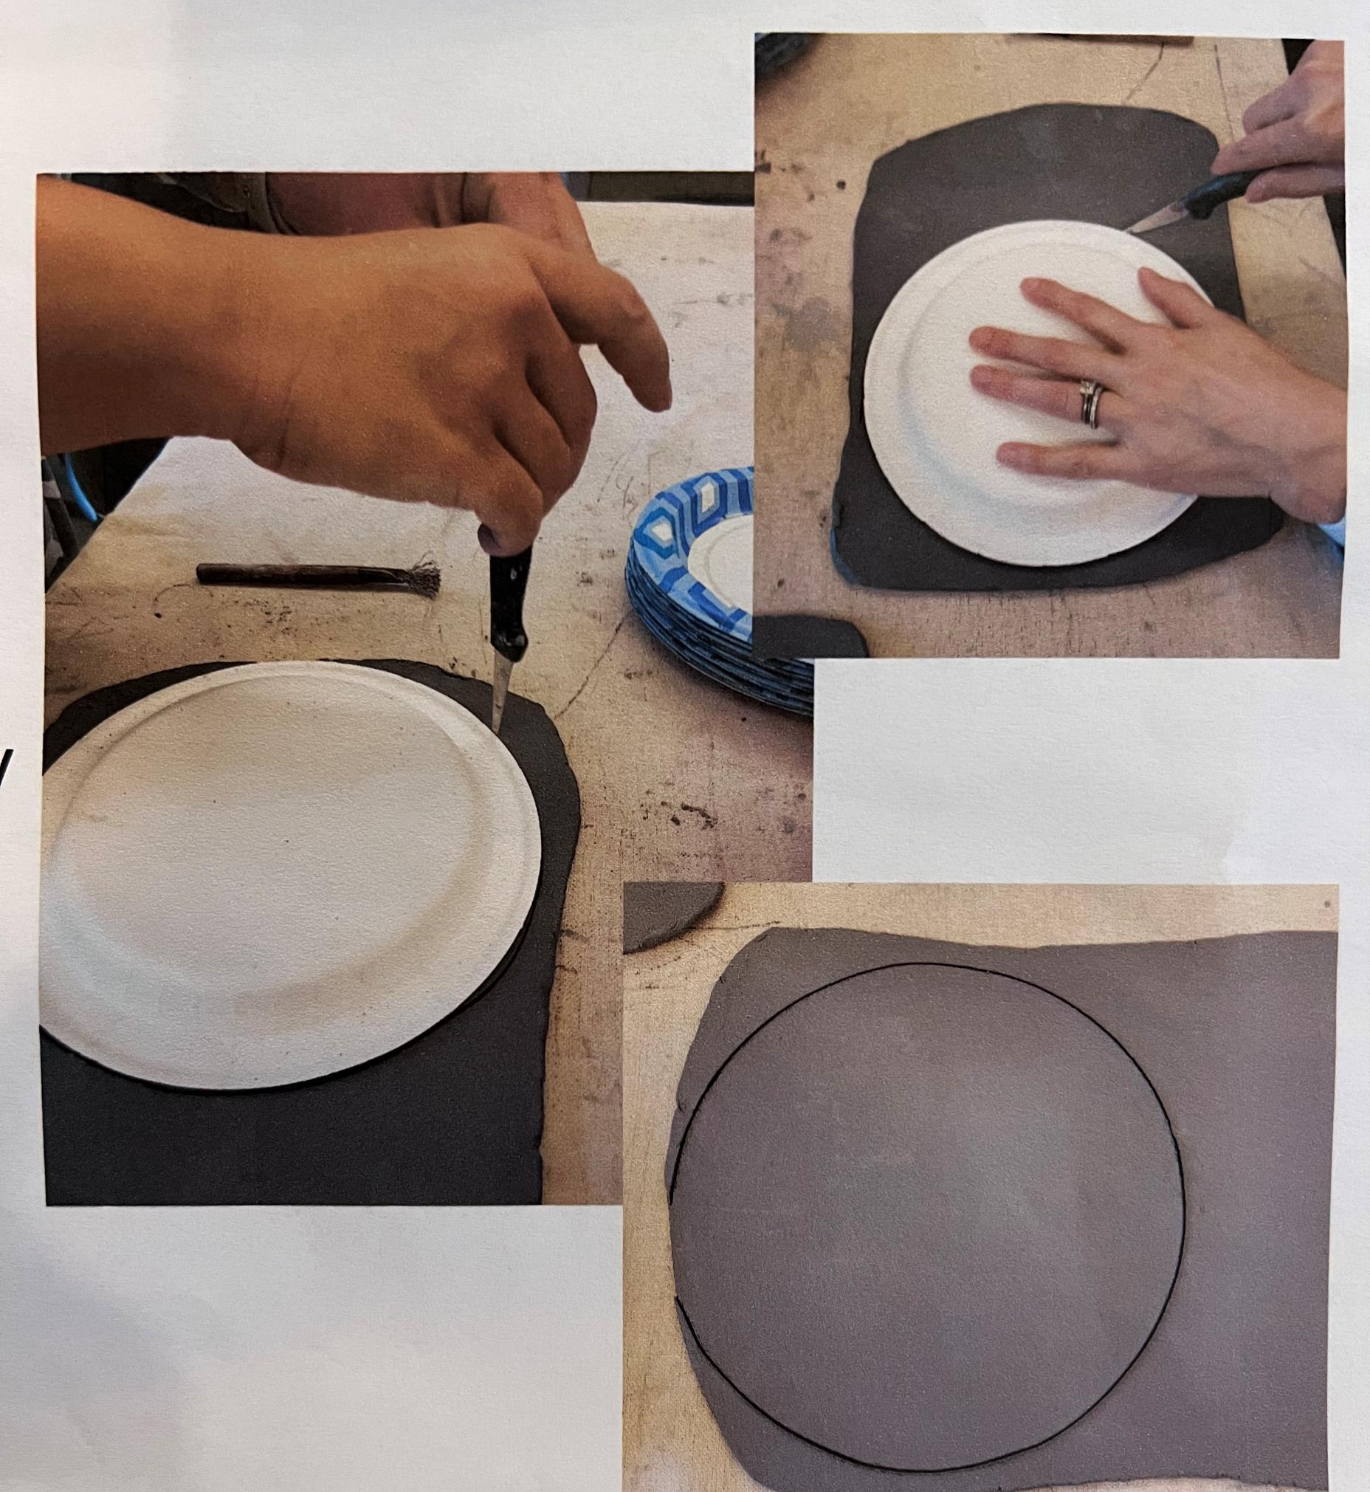
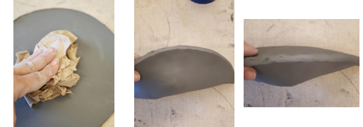
Make Your Dragon
Trace
Use plate template to trace a circle on your clay slab.
Cut
Cut it out with your dull knife. Keep your scraps loose…do not crumple them into a ball!
Place
Place 3 loosely scrunched paper towels in the center of the clay circle.
Fold
Gently fold your circle in half like a taco
Pinch
Pinch the taco around the edges to seal the taco…now it is a wonton!
Notes:
Materials needed:
Clay slabs (one per student)
Paper plates
Clay tools
Paper towels (3 x number of students)
Slip with paint brushes
Wet sponges

Slide 15
Dragon directions
Squeeze
Squeeze gently the ends to pull a head and a tail from the clay. Focus on the head first giving your dragon a snout, eyes and ears, horns etc…
Dragon’s Tail
Work on the dragon’s tail. Create a moving look by shaping the tail in a curve.
Details
Give your dragon texture, details, scales etc. with popsicle sticks, and different texture tools.

Slide 16
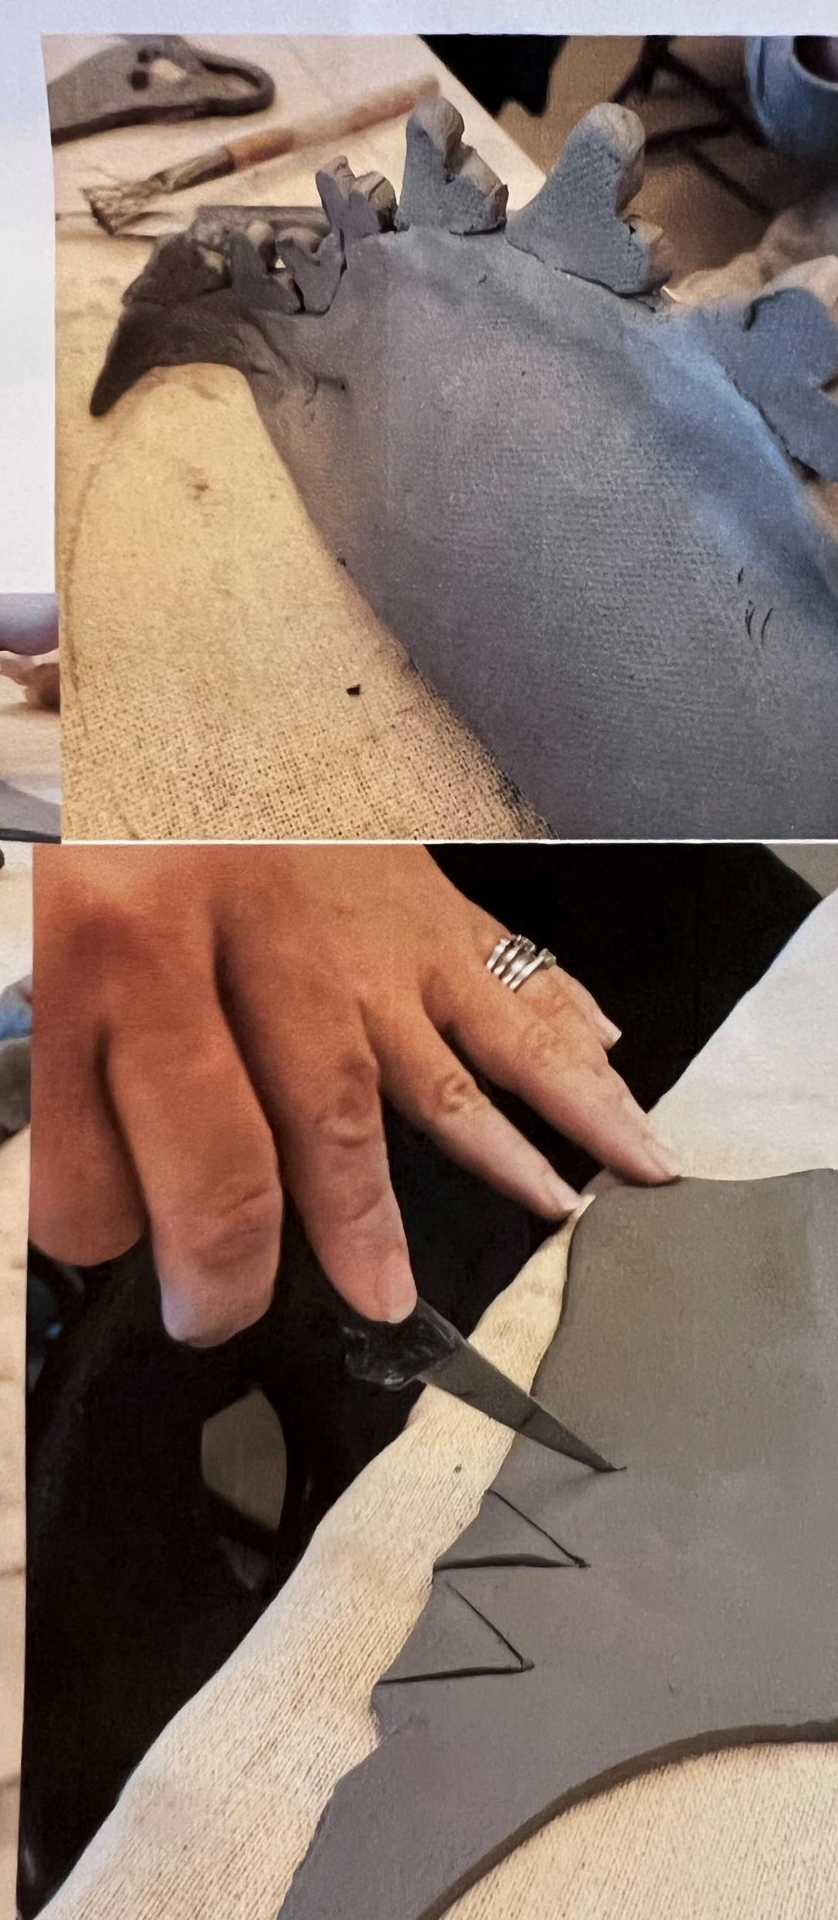
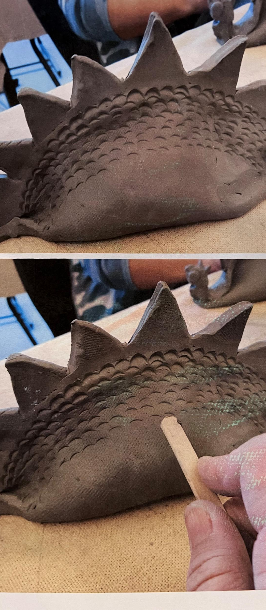
Notes:
Use the popsicle sticks, paperclips, and pencils to create texture on your dragon. Practice on your scraps first if you like.
REMEMBER that the dragon is hollow. Do not press through the dragon. Use gentle pressure with the tools.
Add dots, noses, wavy lines, scales, skin or lines. Is your dragon happy, sad, playful, protective, peaceful or fierce?

Slide 17
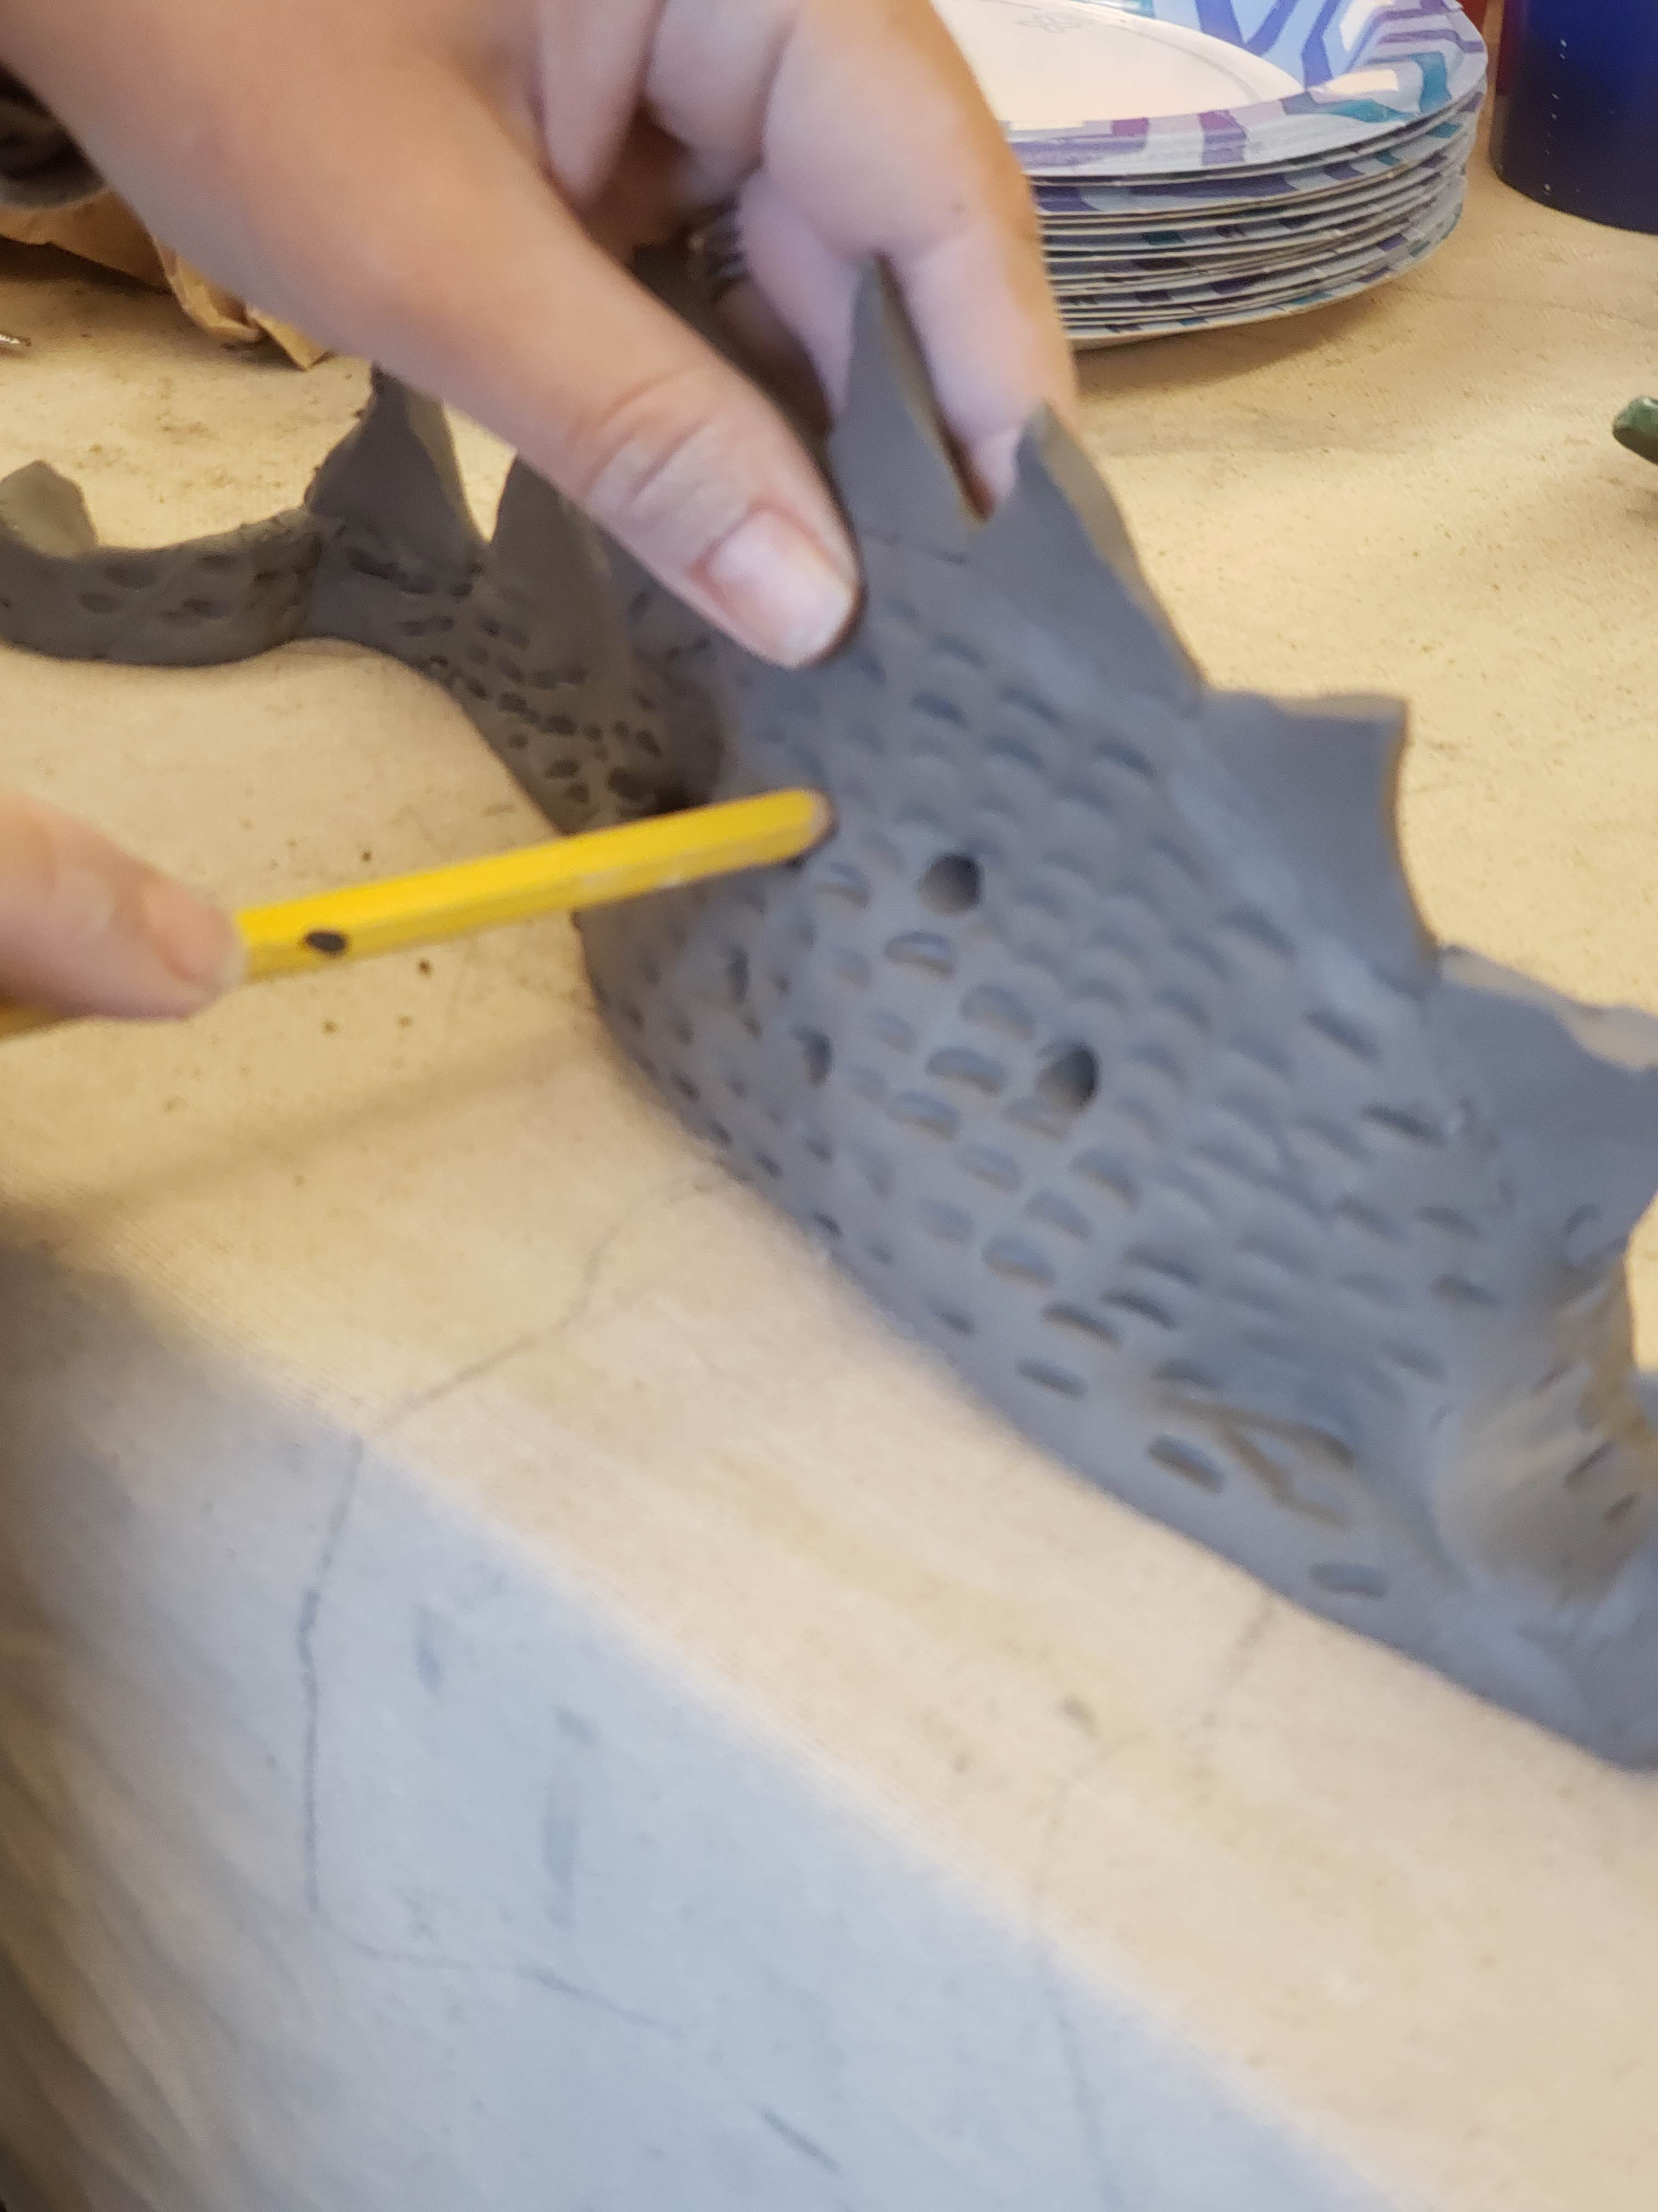
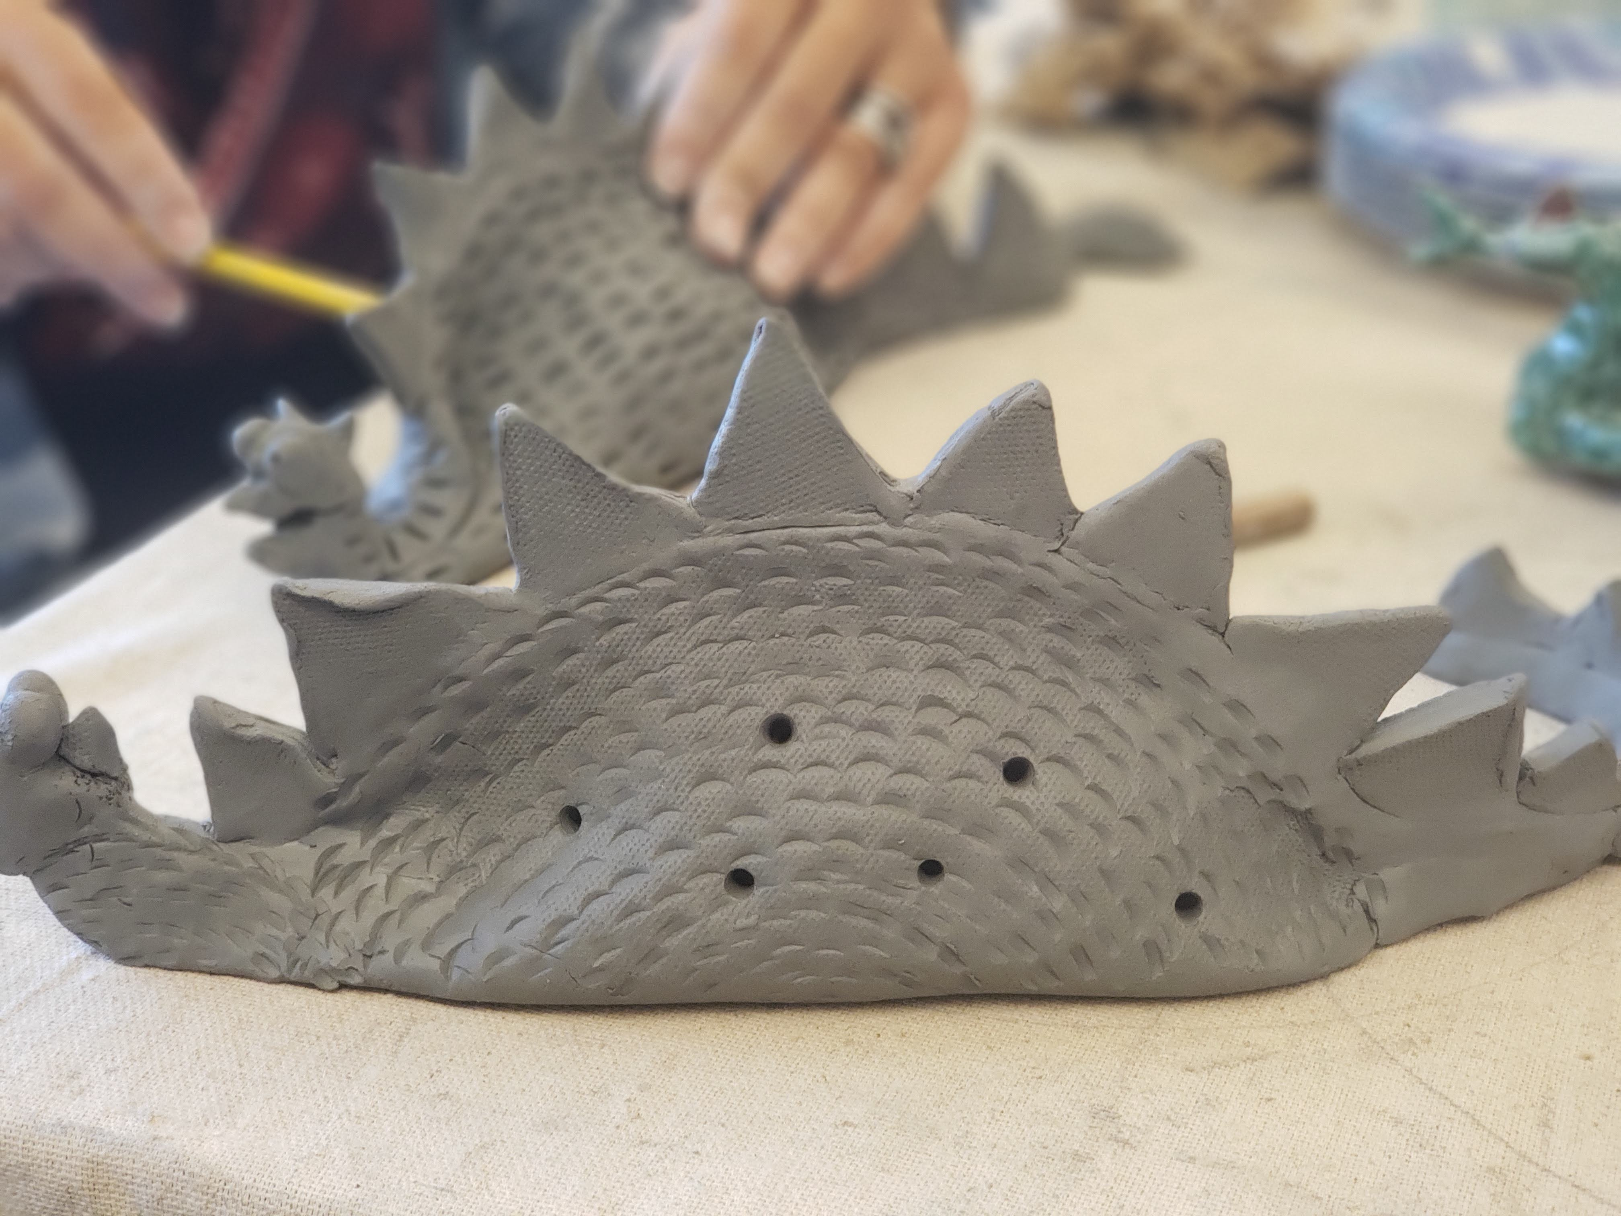
Add 6 small skewer holes on each side of your dragon using a dull pencil. This will allow a tea light to be placed inside so it will glow!
Add your names/initials very clearly on the bottom near the tail.
LAST step…cut a hole out of the bottom. Be sure to leave a good rim around the bottom to support your dragon weight, but circular to fit a standard tea light. Remove all the paper towels using a back and forth motion to prevent ripping of the clay. The paper towels will be reused with the next class.

Slide 18
Dragon directions
Cut a hole out of the bottom. Be sure to leave a good rim around the bottom to support your dragon weight. Remove all the paper towels and flatten out. They will be reused with the next class.
LAST step… Add your name/initials very clearly on the bottom somewhere

Slide 19
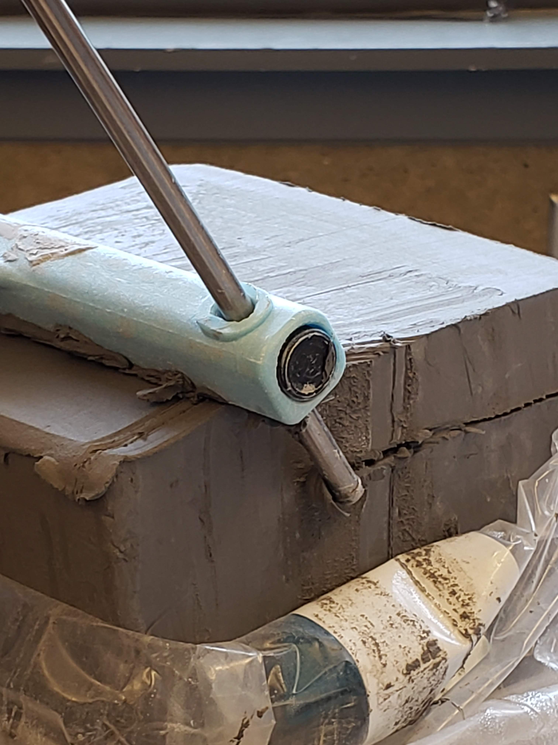
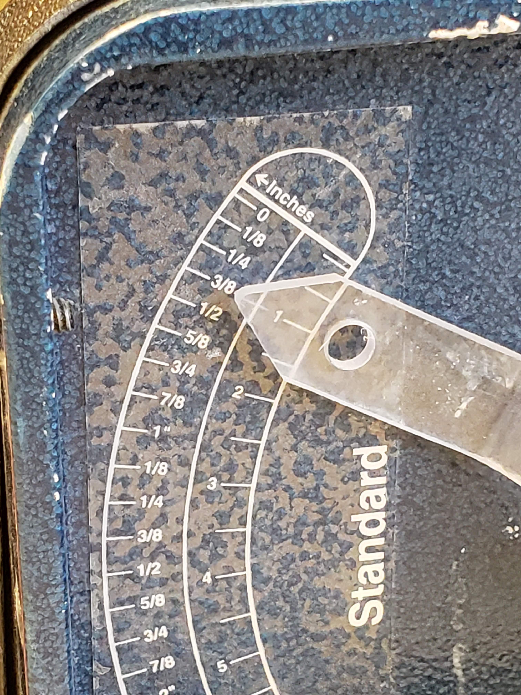
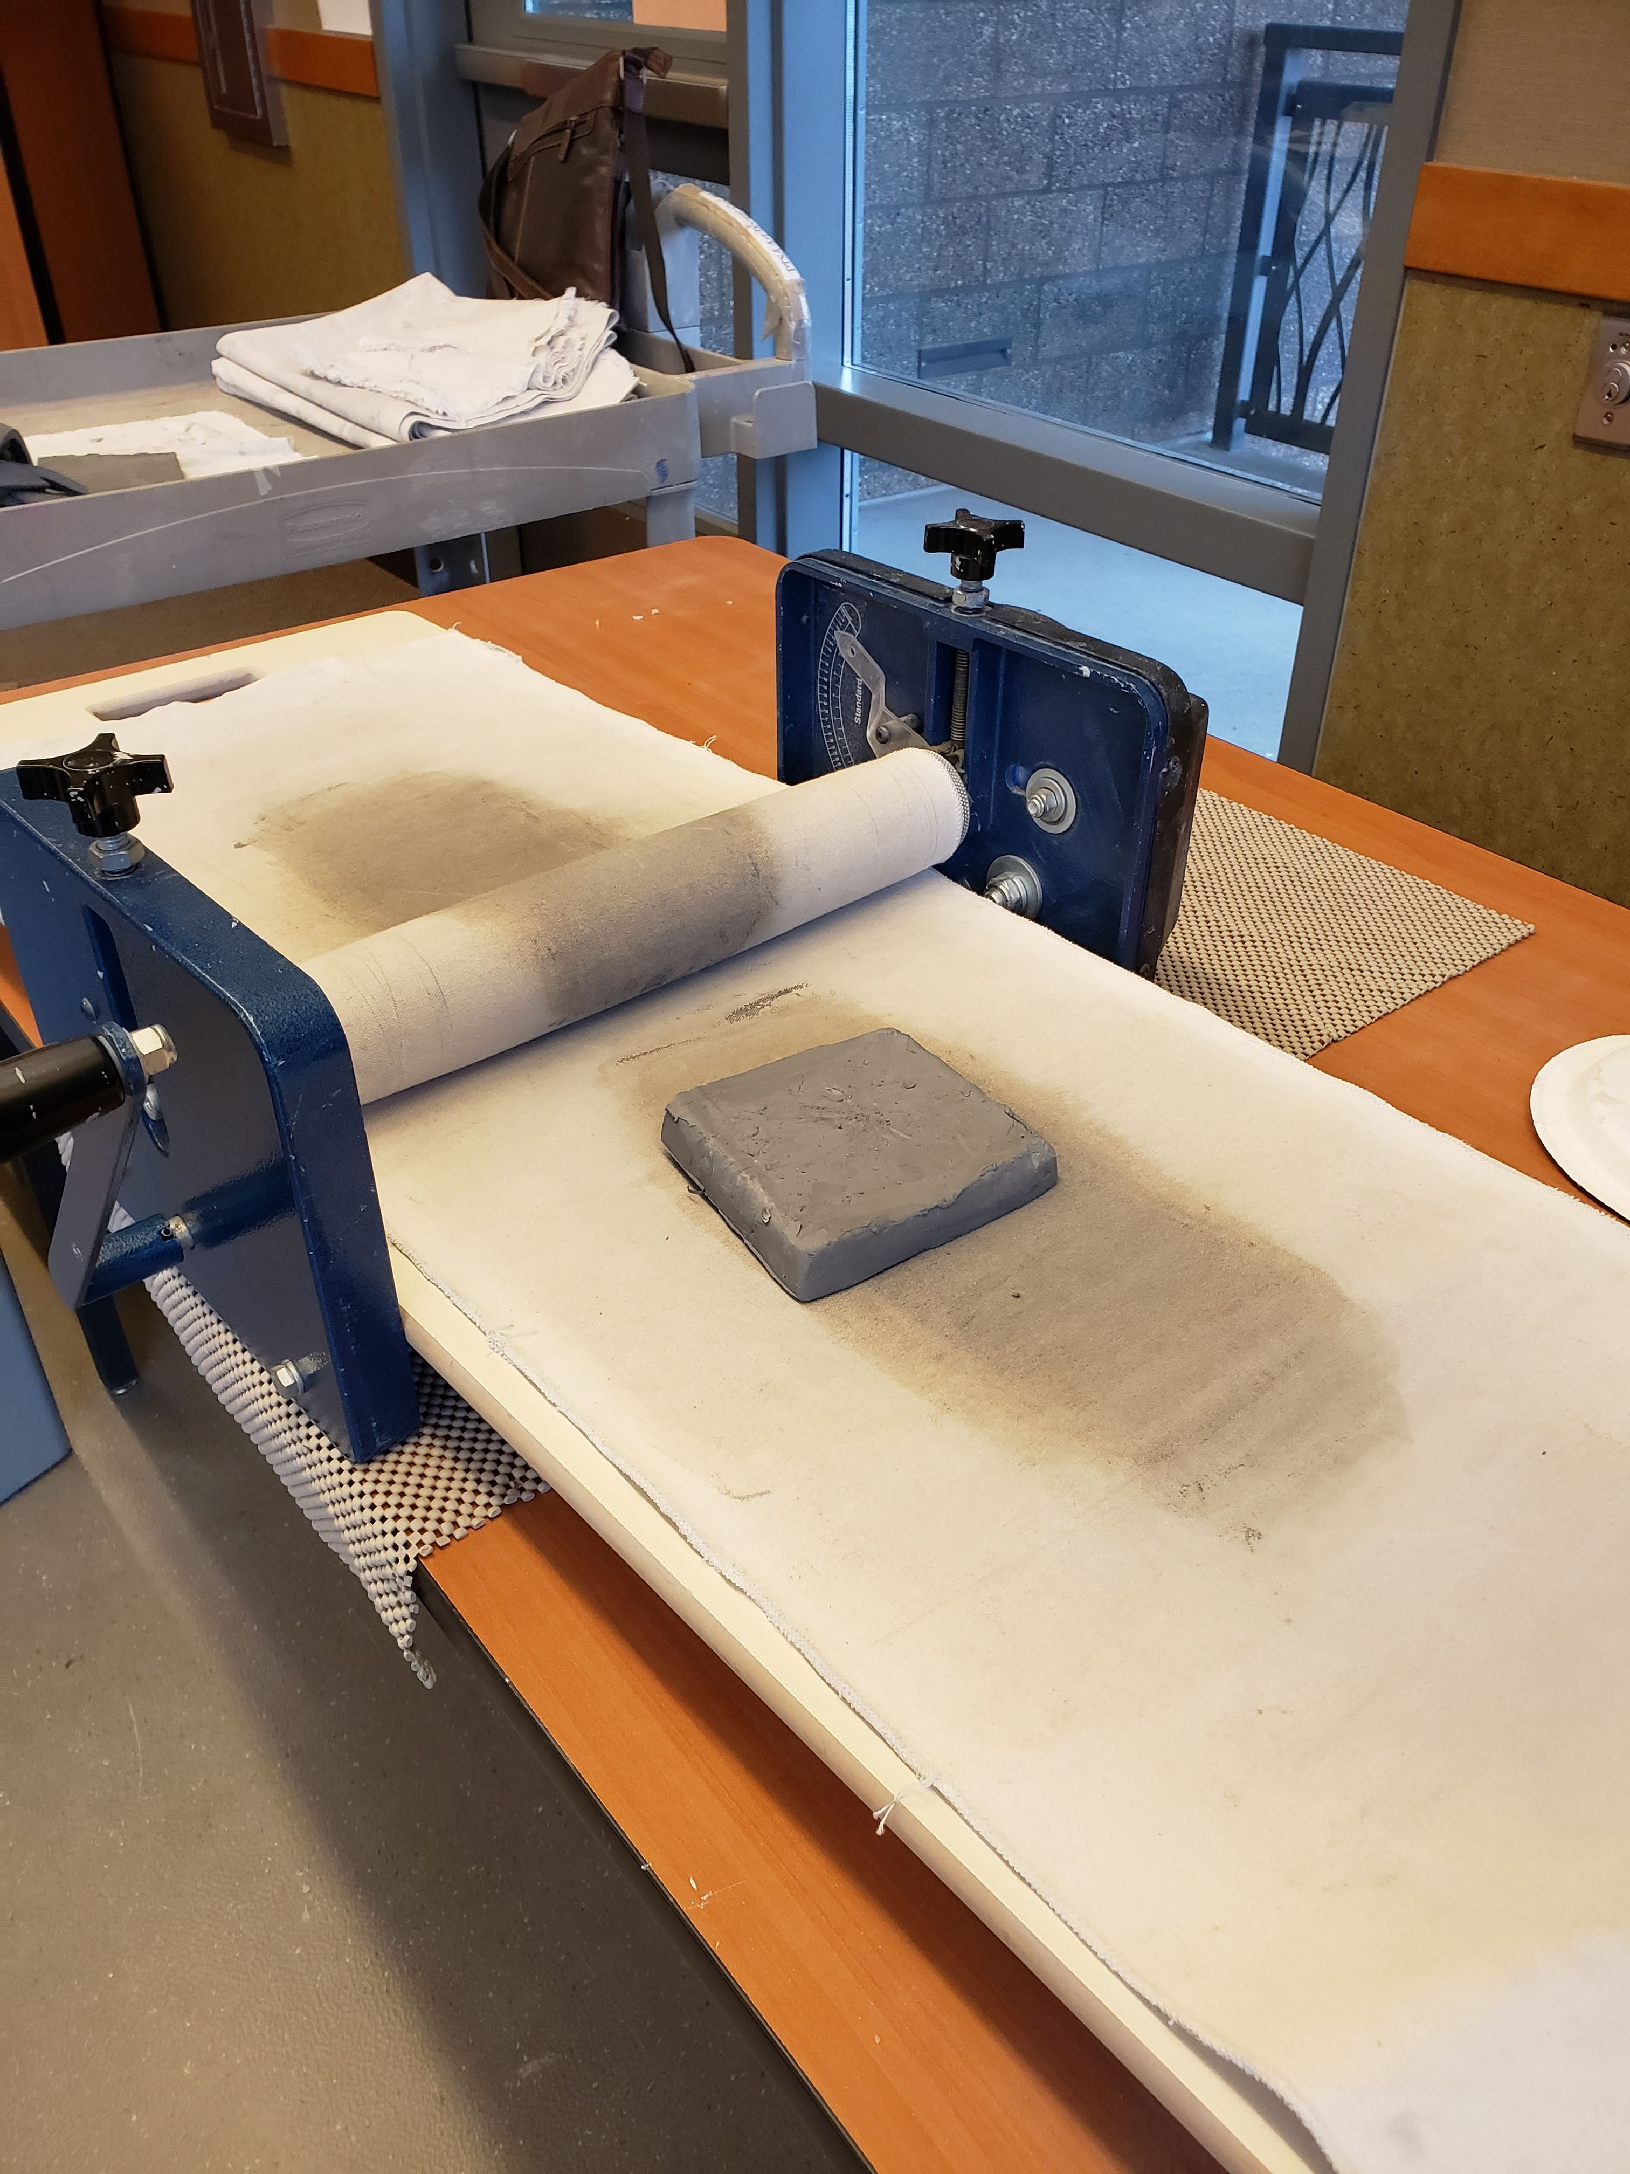
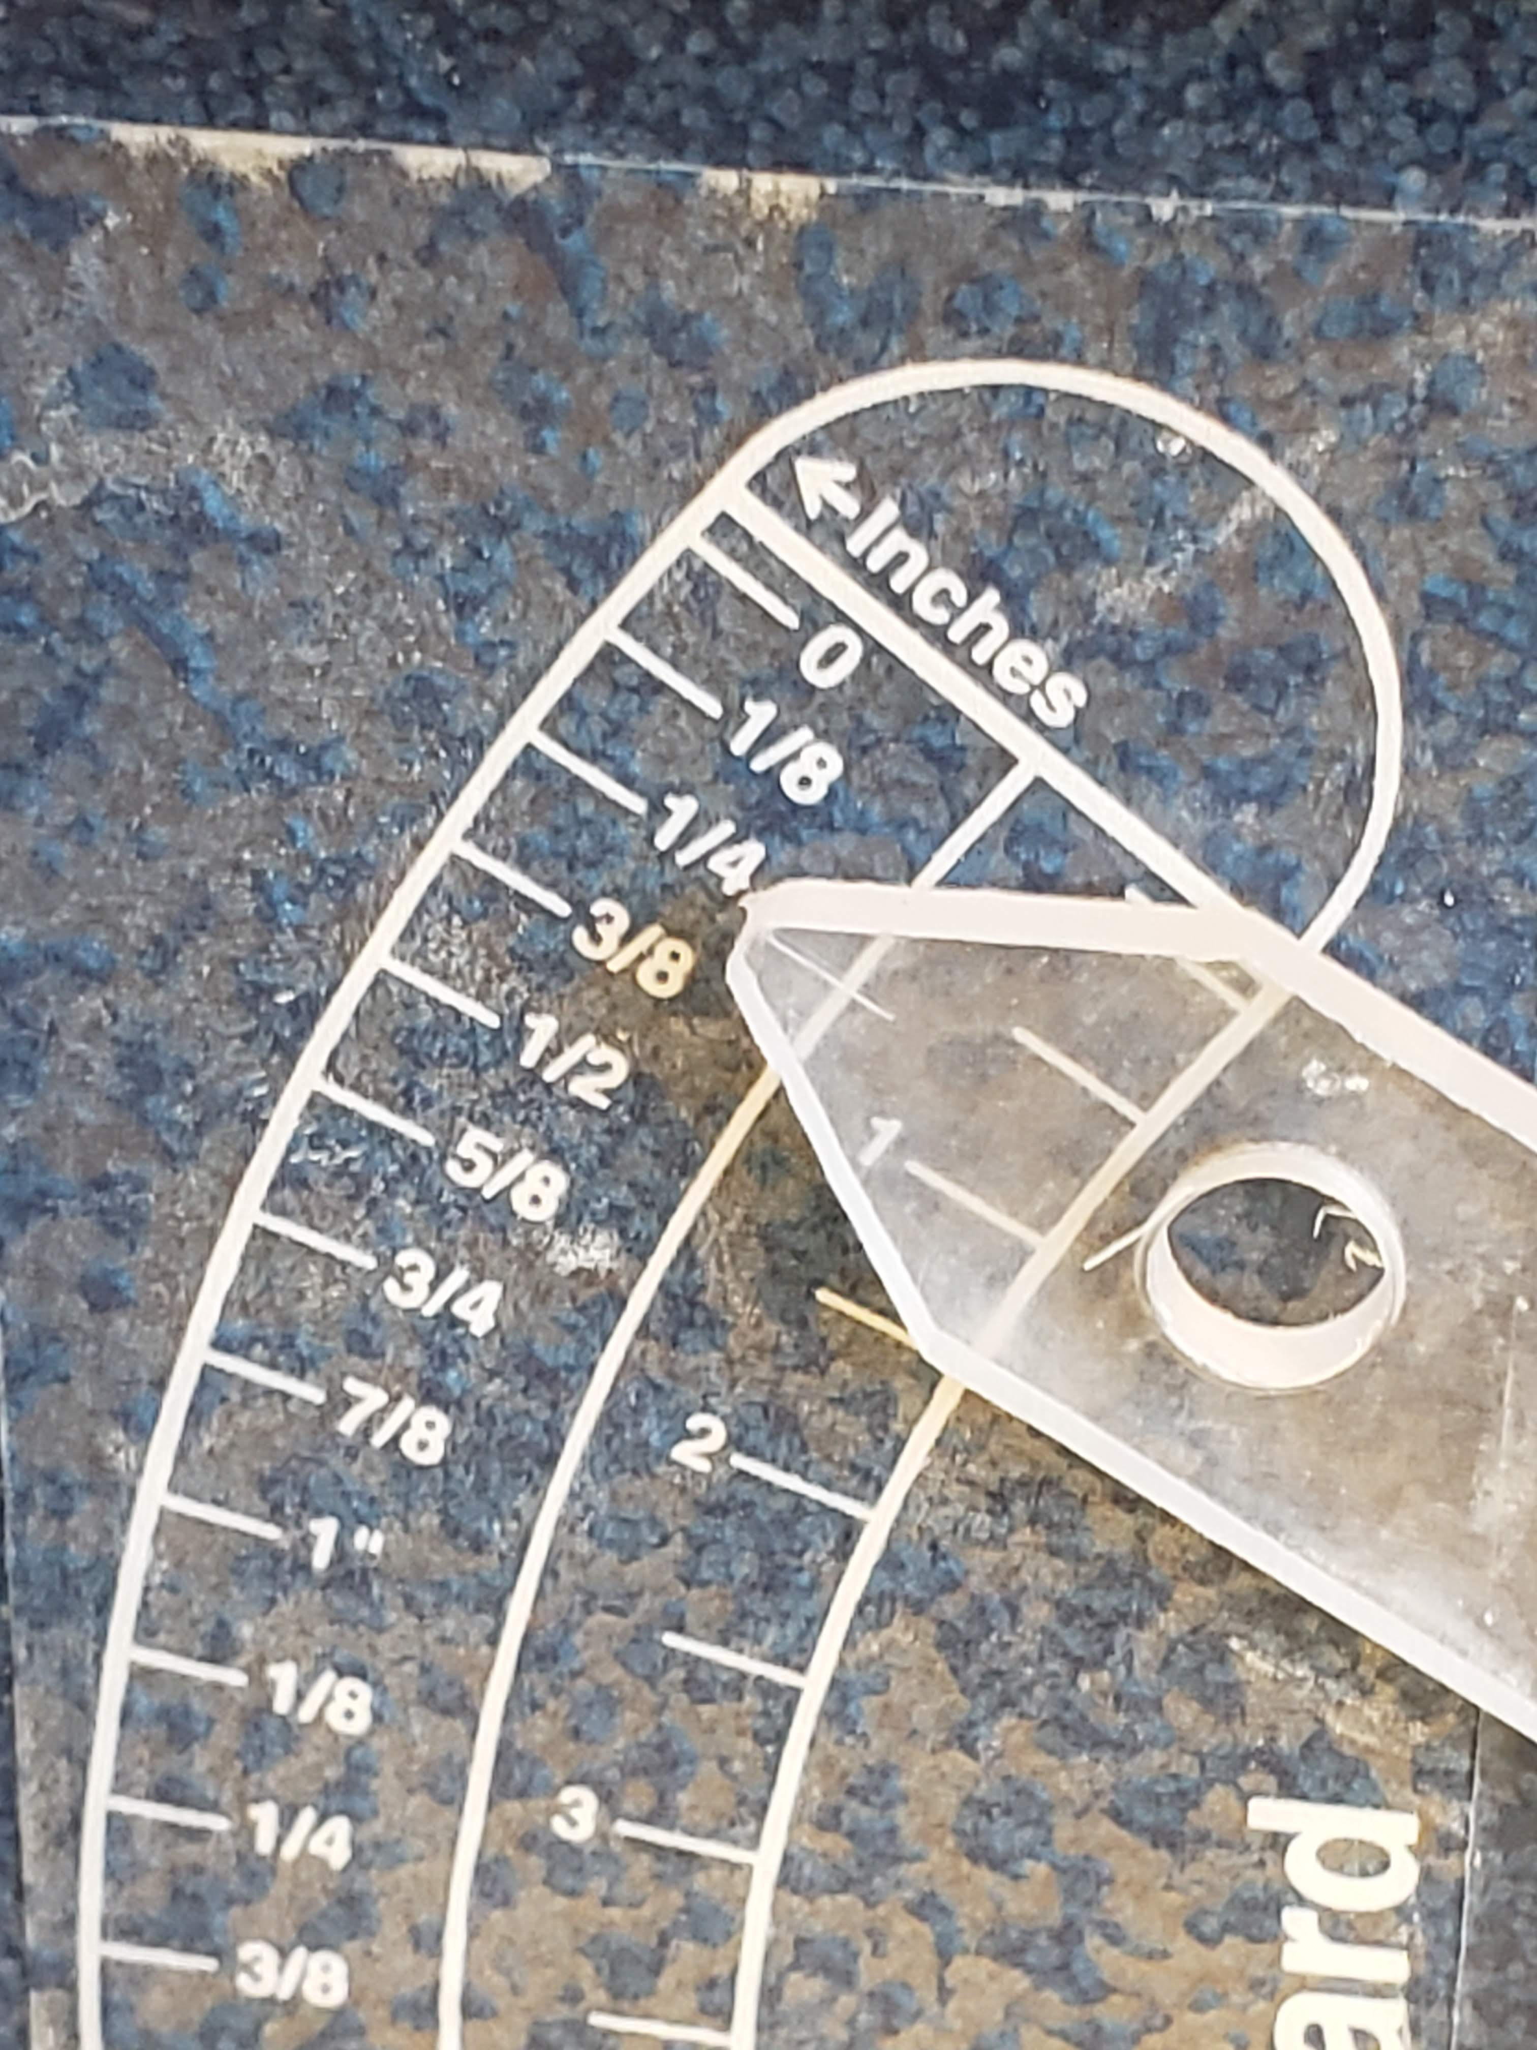
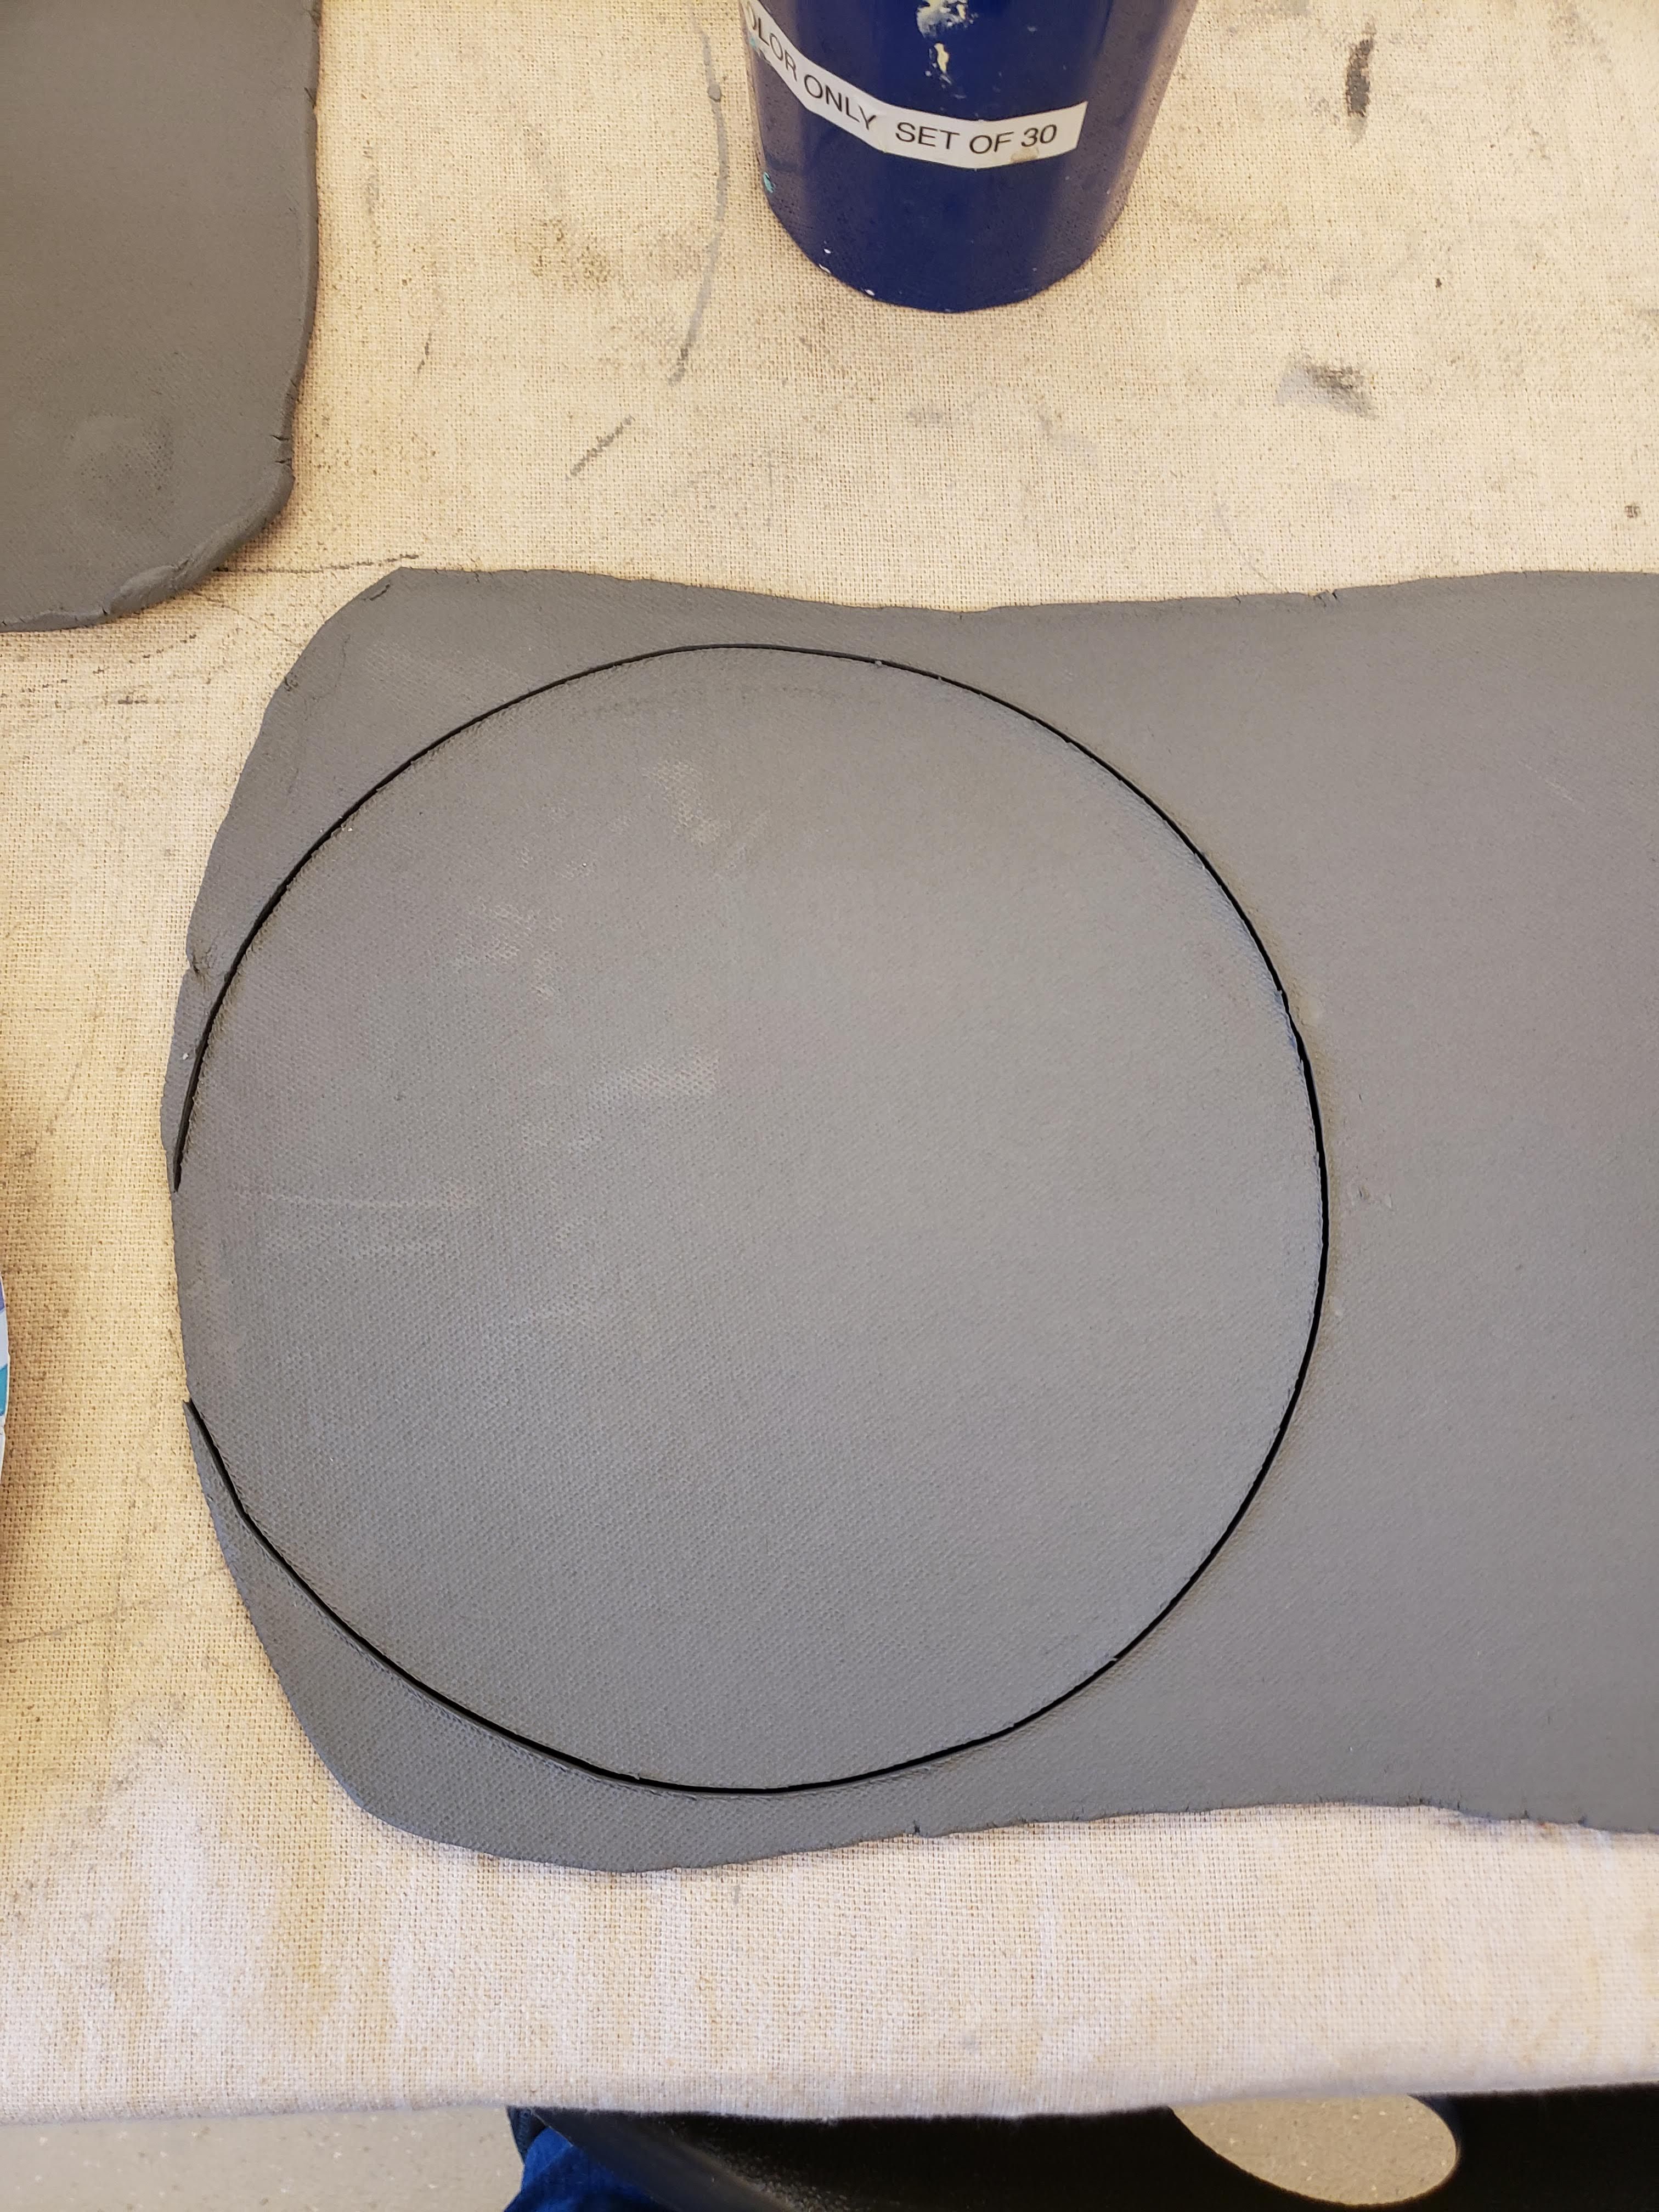
1st cut chunks from the bag. Approx. 1 1/8 inch thick.
2nd Roll 2 chunks at a time side by side at 3/8” roller depth
This only shows one chunk. Place side by side to run 2 chunks at time.
Store the slabs in bins with a tight lid to prevent from drying out. Use plastic bags inbetween layers, and plenty of damp paper towels in each layer to keep the clay moist. DO NOT stack all the bins. The weight will crack the lids.
3rd Turn the slab ¼ turn and roll the second time at ¼” depth. You can roll 2 slabs at once.
Slab should create a squarish shape.

